Slide 1
A PASSWORD STRENGTH EVALUATION ALGORITHM
Team Details
TEAM-09
B.Mounika(20EG105404)
K.Surya Teja(20EG105418)
P.Manvitha(20EG105434)
Project Supervisor
Dr.K.Madhuri
Associate professor

Slide 2
INTRODUCTION
There is an increasing importance for information security with internet as a platform.
To identify a user, password authentication is very much needed. Despite having access to both information security and authentication, users often give weak passwords because it is convenient for them to remember.
However, today’s password strength evaluation methods do not necessarily consider user’s personal information, which in turn leads to security vulnerabilities.
A password strength evaluation algorithm essentially based on user’s personal information would improve the security of password , letting the user know when a password is weak and also when it is strong.

Slide 3
PROBLEM STATEMENT
A password strength evaluation system allows the user know when their password is weak and also when it is strong. It is needed because the user always tries to fill out a password that is easy for them to remember. The existing methods, like rule based method, pattern matching method and attack algorithm have their drawbacks and work for limited parameters. The implemented, structure Segmentation and Bi directional algorithms give the relationship between passwords and users’ personal information, but they do not provide the strength and feedback to the user.

Slide 4
EXISTING METHODS
There are existing methods, like rule based method, pattern matching method and attack algorithm. Every method has a drawback and works for limited parameters.
Structure segmentation and Bi-directional algorithms:
It is to investigate how user’s personal information is included into their passwords.
Structure segmentation characterizes the information provided and divides it into segments.
Every type of information is divided accordingly.
Bidirectional matching algorithm checks if the password comprises of personal information. It gives tag numbers.
For example, if tag is 0, it means the password is matching with the name of the user.

Slide 5
PROPOSED METHOD
This proposed method investigates how the user’s personal information is incorporated into their passwords while also measuring a correlation between them. And then password strength evaluation method is processed.
Some of the key areas of the system are:
Basic preprocessing.
Scoring algorithm.
User Feedback algorithm.

Slide 6
PROPOSED METHOD
Basic preprocessing:
A set of passwords are analyzed initially using logistic regression, XG Boost , Naive Bayes and Decision Tree for their strengths. Then these algorithms are compared to find out which one is most accurate.
Scoring algorithm:
The scoring algorithm is used to evaluate the password strength based on information . The algorithm assigns score to a password and categorizes it into levels of strength . Hence , making it easier for users to understand the strength of their passwords.
User Feedback algorithm:
It guides users on creating strong passwords by considering length, complexity, and the use of personal information in a secure way. Users receive specific suggestions for improving their passwords based on the algorithm's analysis.

Slide 7
EXPERIMENT ENVIRONMENT
Data set is collected from kaggle for pre processing .
Pandas , Numpy , Matplotlib , Seaborn, Tfidfvectorizor, Logistic regression , XG boost, MultinomialNB , Decision Tree Classifier are used for Data manipulation and visualization .
Visual studio code and Google Collab notebook are used for code development.
Python Programming language is used for implementing the algorithms (Structure Segmentation , Bi-Directional Matching , Scoring and User Feedback ) .

Slide 8
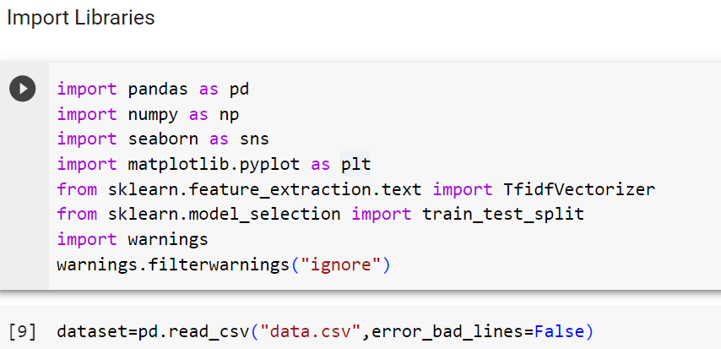
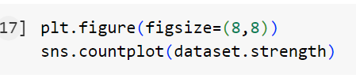
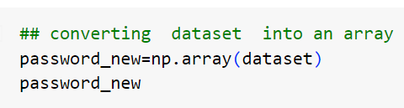
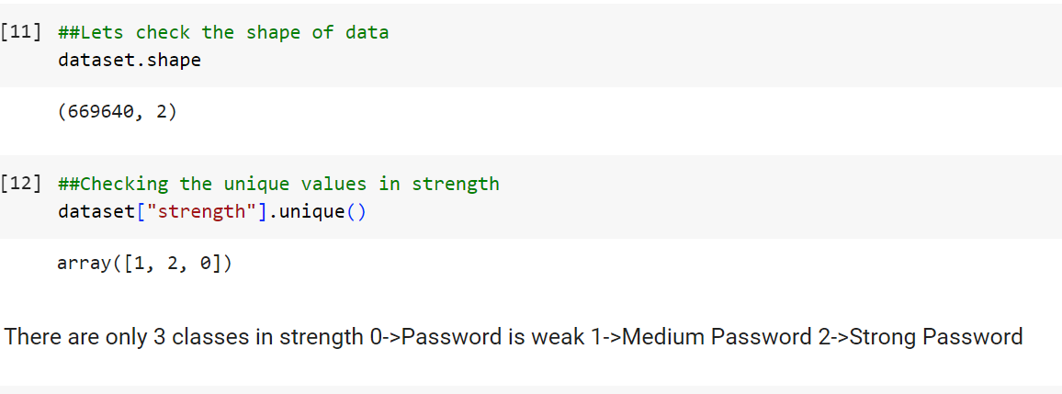
EXPERIMENT SCREENSHOTS
Basic preprocessing:

Slide 9
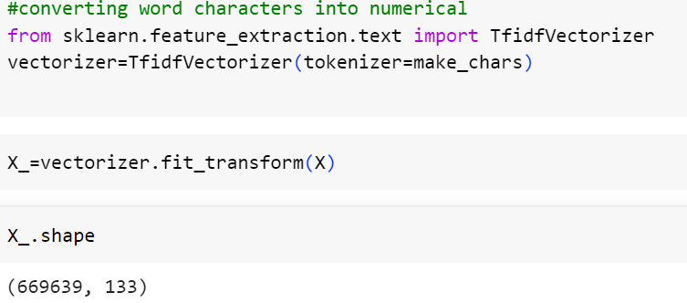
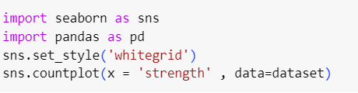
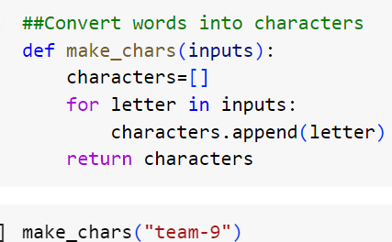
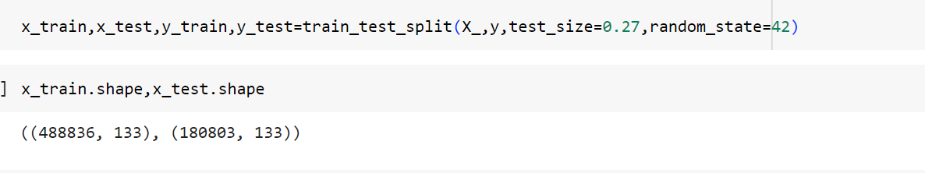

Slide 10
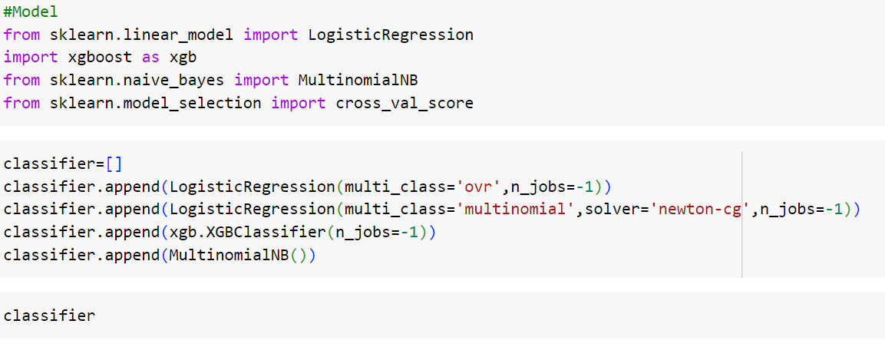
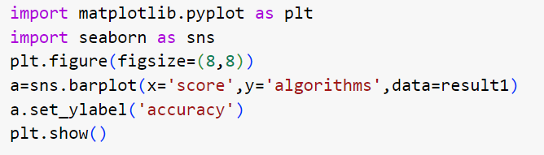
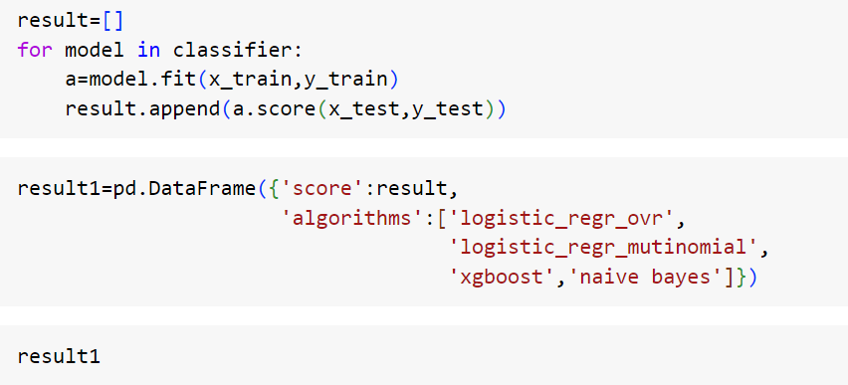
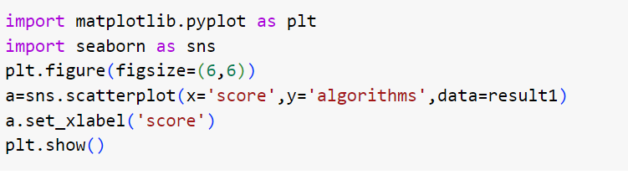

Slide 11
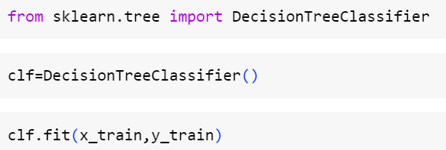
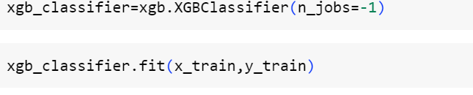
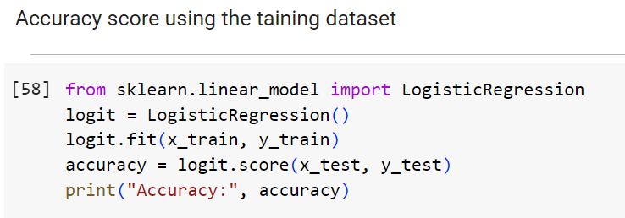
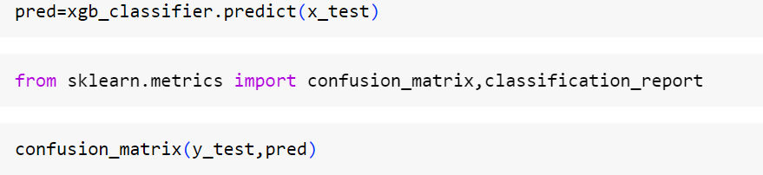
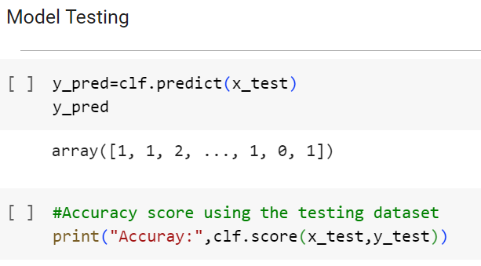

Slide 12
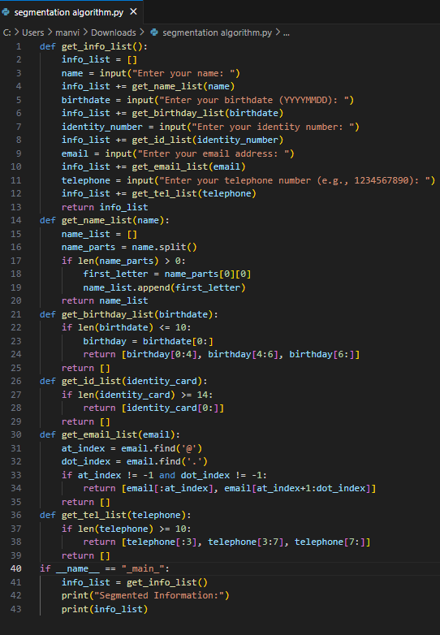
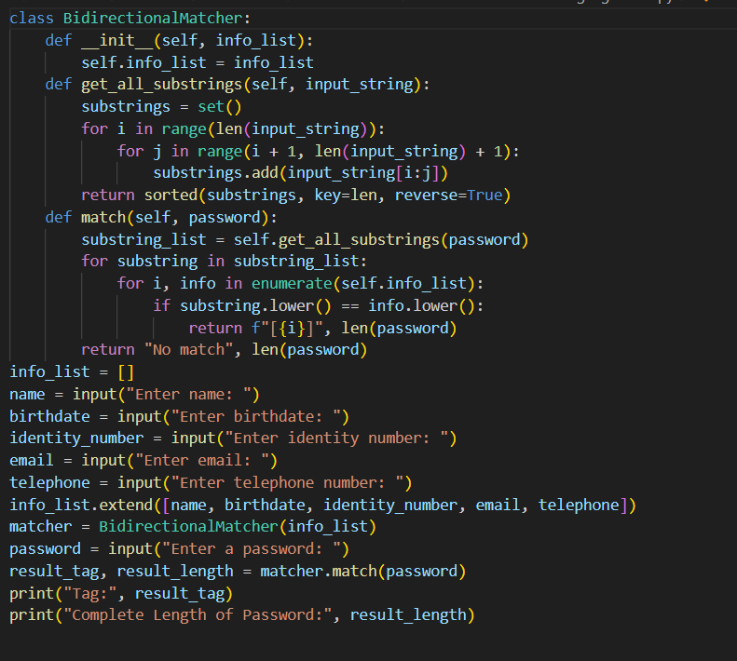
Segmentation Algorithm : Bi-Directional Matching Algorithm:

Slide 13
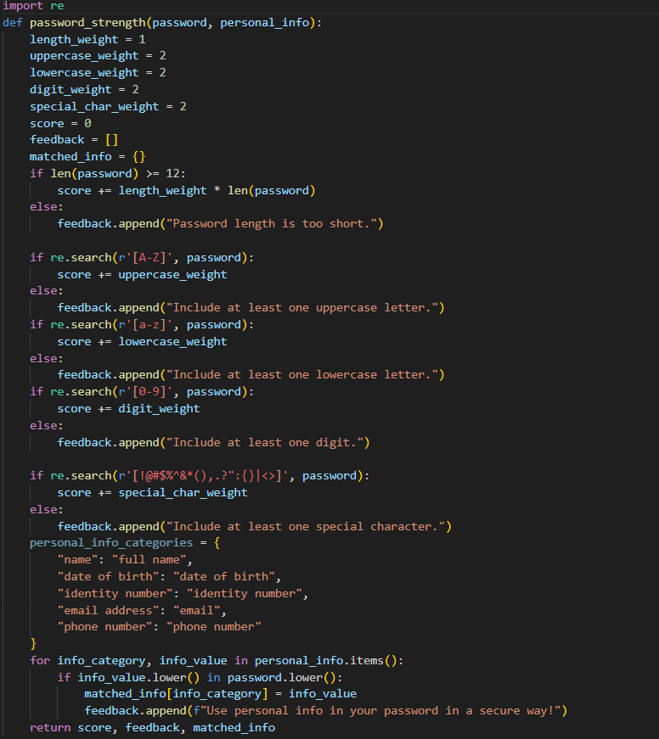
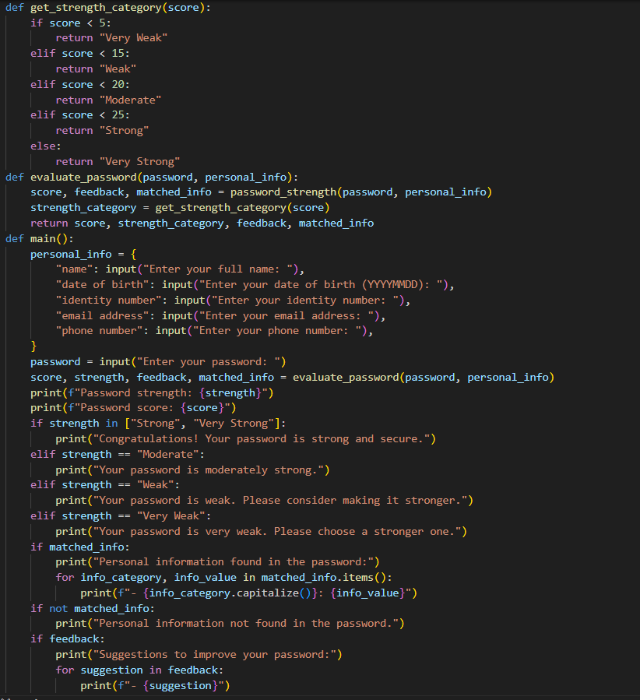

Combination of Scoring and User Feedback Algorithm

Slide 14
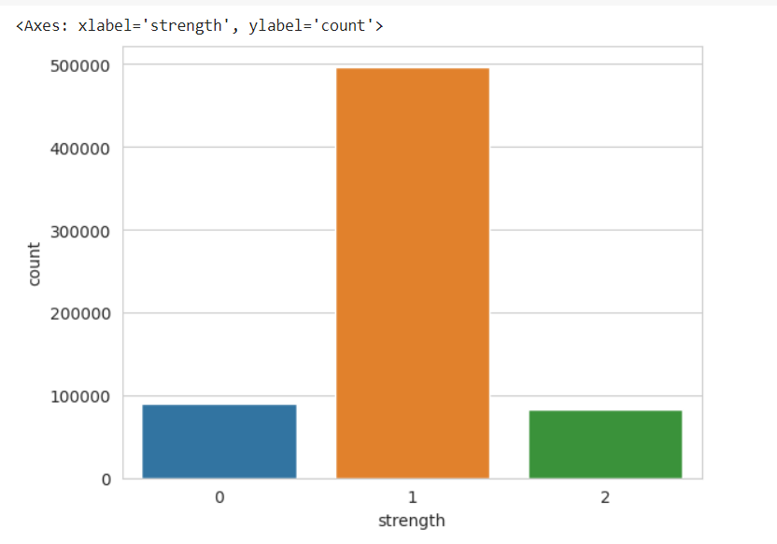
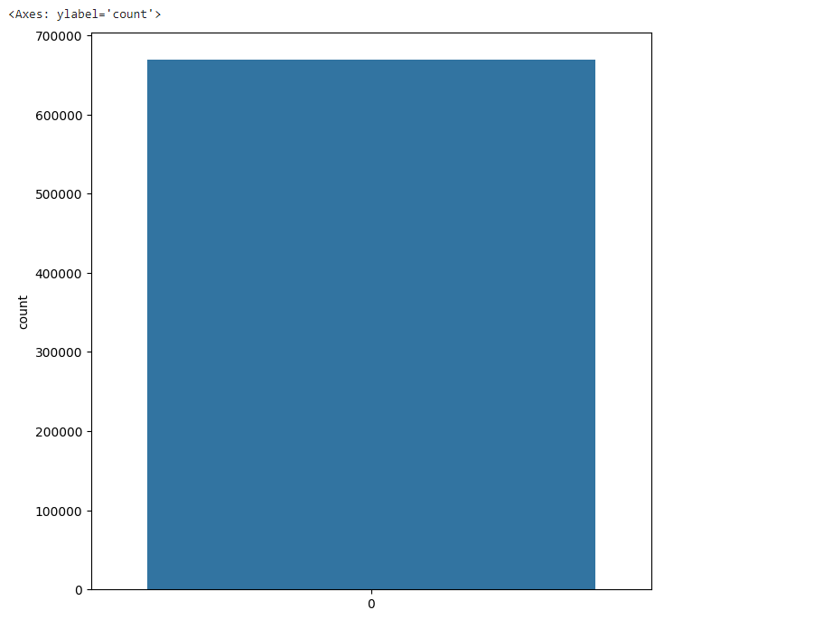
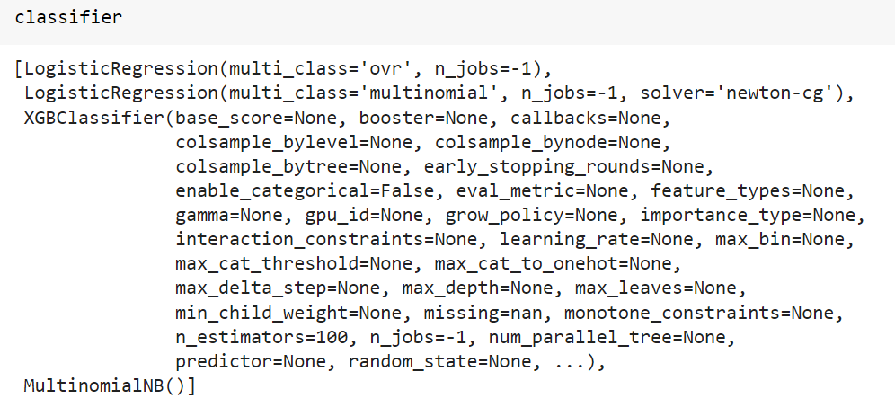
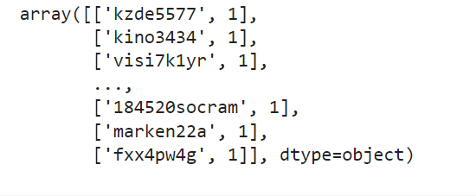
EXPERIMENT RESULTS
Basic preprocessing:

Slide 15
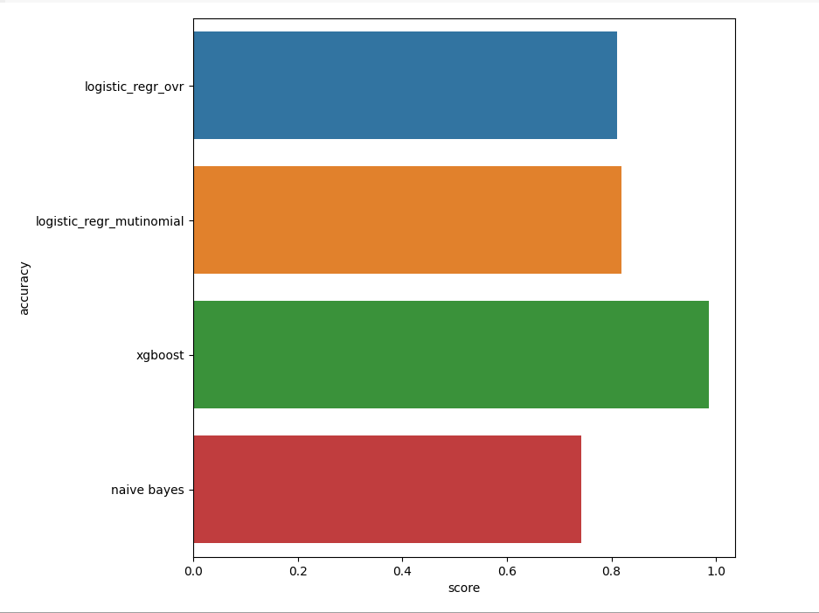
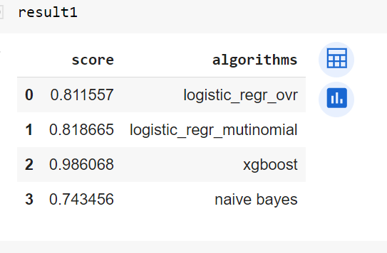

Slide 16
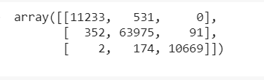
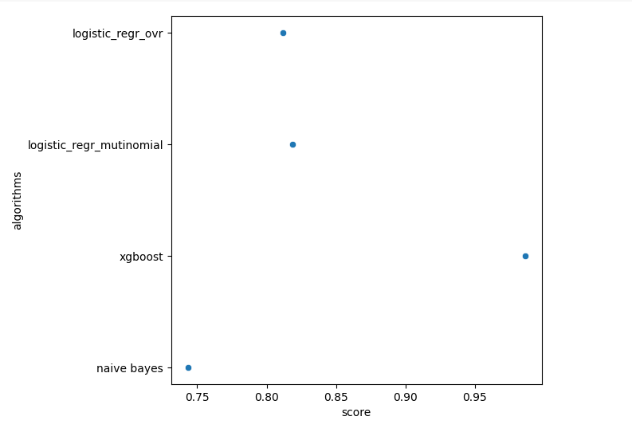
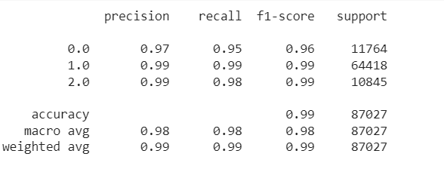
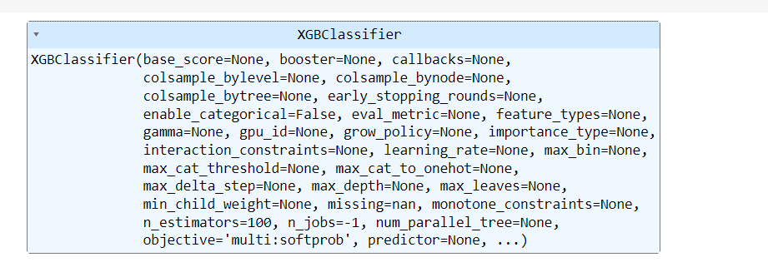

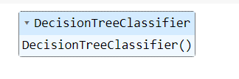


Slide 17
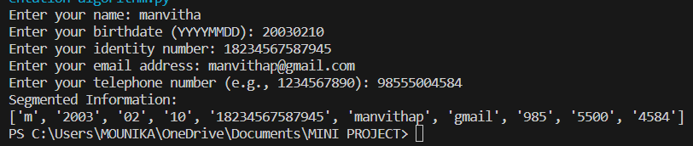
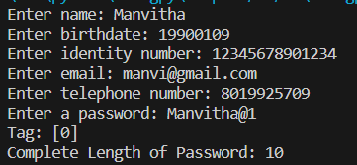
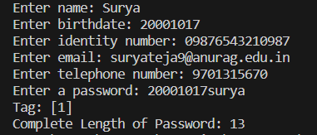
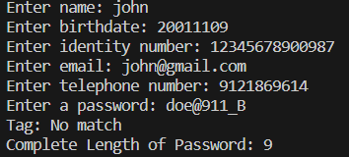
Segmentation algorithm:
Bi Directional Matching algorithm :

Slide 18
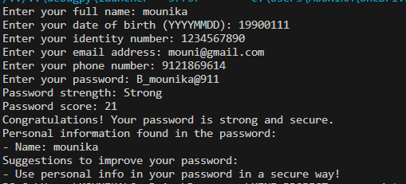
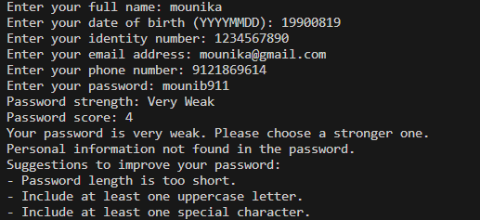
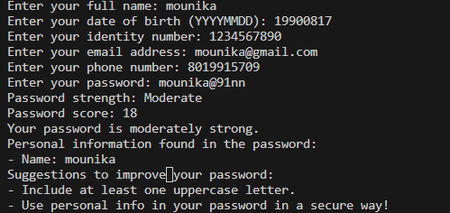
Scoring and User Feedback Algorithm

Slide 19
FINDINGS
In initial preprocessing and analysis, we’ve found that XG boost and Decision Tree Classifier are giving the most accurate value in the analysis of password strength while also using Logistic regression and Naive Bayes.
Provided inputs are segmented in the form of lists , when Structure Segmentation Algorithm is used.
Bidirectional Matching Algorithm gives tags as output when password is provided. If tag value is 0 , then it matches to the name, if tag value is 1, then it matches to date of birth,if tag value is 2 , then it matches to identity number and so on. If the password is not matched with the users information then it will generate the output as “No Match”.
The combined algorithm of Scoring and User Feedback Algorithms give the user, attributes like, score, password level strength and also suggestions to improve.

Slide 20
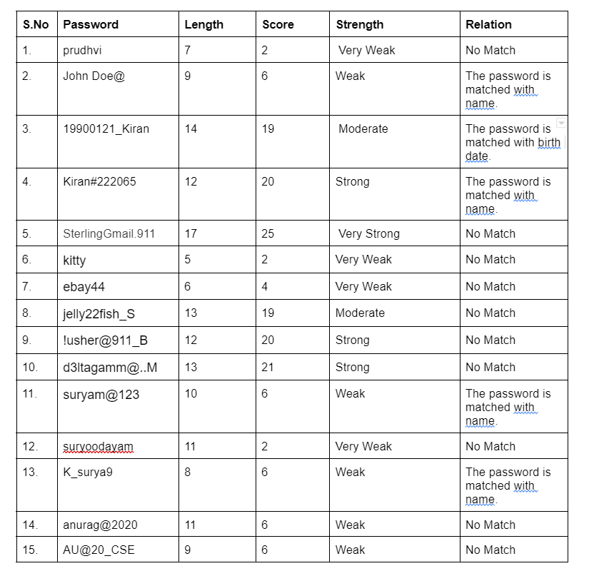

Slide 21
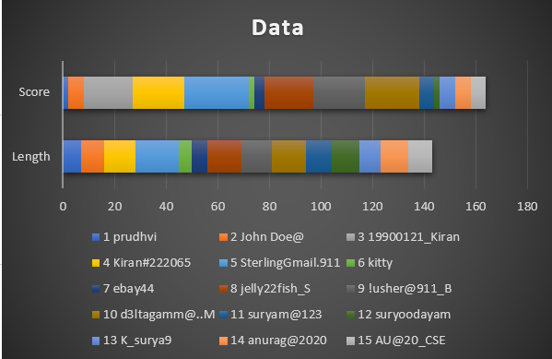
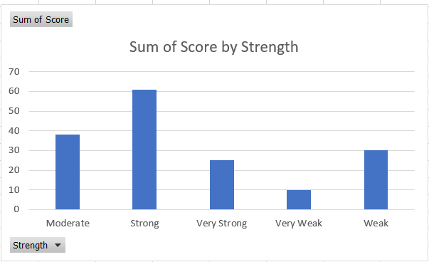

Slide 22
JUSTIFICATION
1.The parameters improved by the proposed system are:
Scores of passwords
Strength of passwords
User Feedback
2.We have used a mathematical formula for calculating the score of a password’
score+= attribute * len(password)
3. Our parameters have improved as we combined both Scoring Algorithm and User Feedback Algorithm. It increased the performance compared to the previous methods.
Where, attribute=length _ weight [or] uppercase _ weight [or] lowercase _ weight [or] special _ char_ weight [or] digit _ weight

